Slide 1
PANIMALAR ENGINEERING COLLEGE
Department of Computer Science
AI based rectal cancer and stage prediction over web in real-time for general users
Domain:
Artificial intelligence (AI), Web-development
Team Members:
BOGGADA MOUNIKA, Y.EESHA SAI SRI, PANCHETI DIVIJA REDDY
1

Slide 2
Project Overview
With the development of targeted therapies, many treatments are based on molecular studies, which require sampling tumour tissue from paraffin blocks for sequencing. An automated solution could potentially reduce the workload of pathologists by acting as a screening device and may reduce the subjectivity in diagnosis. In tissue-based diagnostics, most of the work still needs to be done manually by a pathologist using a microscope to examine stained slides. The foundation of such tasks is to accurately distinguish cancer/malignant cells from normal/benign cells. However, the determination of tumour content is poorly reproducible with significant variation. As the size of tumour regions can be very small, pathologists are often required to use high magnification for detecting tumour cells. This requirement significantly increases the workload for pathologists. As digital pathology datasets have become publicly available and have opened up the possibility of evaluating the feasibility of applying deep learning techniques to improving the efficiency and quality of histologic diagnosis. In this project we introduce an application to detect Rectal cancer based on Convolutional Neural Network and Ranking algorithm.
2

Slide 3
Challenges in Existing System
In the existing system , the concept of data mining systems supported on cancer prophecy system merging the prediction scheme with mining tools. The categorization algorithms used in the existing system is called decision tree. The user enters into the cancer prophecy scheme, and then required to retort the queries, connected to genetic and non-genetic skin textures. In that case the prediction structure allots the hazard rate to both query bases on the client retorts. One time the exposure significance is estimated, the series of the coercion preserve is resolute by the forecast structure. Research data shows that the accuracy of cancer prediction system is about 73%. ​

Slide 4
Proposed System
With the development of targeted therapies, many treatments are based on molecular studies, which require sampling tumour tissue from paraffin blocks for sequencing. An automated solution could potentially reduce the workload of pathologists by acting as a screening device and may reduce the subjectivity in diagnosis. In tissue-based diagnostics, most of the work still needs to be done manually by a pathologist using a microscope to examine stained slides. The foundation of such tasks is to accurately distinguish cancer/malignant cells from normal/benign cells. However, the determination of tumour content is poorly reproducible with significant variation. As the size of tumour regions can be very small, pathologists are often required to use high magnification for detecting tumour cells. This requirement significantly increases the workload for pathologists. As digital pathology datasets have become publicly available and have opened up the possibility of evaluating the feasibility of applying deep learning techniques to improving the efficiency and quality of histologic diagnosis. In this project we introduce an user facing AI based application to detect and predict the stage of Rectal cancer based on CNN with Attention mechanism and Ranking algorithm.
4

Slide 5
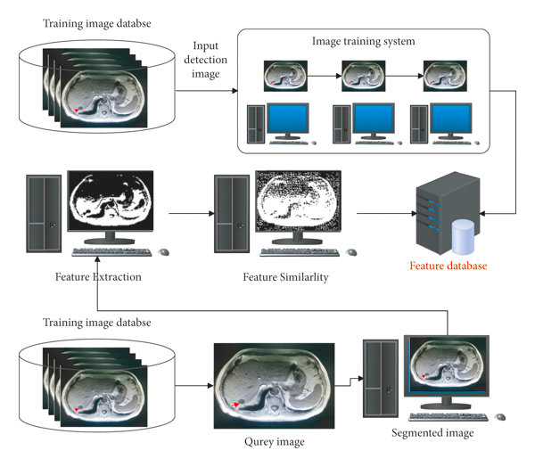
SYSTEM ARCHITECTURE

Slide 6
Software Requirement Specifications (SRS)
PURPOSE:
we introduce an user facing AI based application to detect and predict the stage of Rectal cancer based on CNN with Attention mechanism and Ranking algorithm. An automated solution could potentially reduce the workload of pathologists by acting as a screening device and may reduce the subjectivity in diagnosis.
IN-SCOPE:
A web application where user can upload their Scanned tissue sample image to get the prediction
Training the Model with realtime open source Rectal cancer tissue sample
User get a prediction report consisting of Stage of cancer and matching similar types of tissue list

Slide 7
Feasibility Study
reduce the workload of pathologists by acting as a screening device and also reduce the subjectivity in diagnosis.
Inclusion of feature in Scanning Devices for Quick analysis
possibility of evaluating the feasibility of applying deep learning techniques to improving the efficiency and quality of histologic diagnosis.

Slide 8
AREAS OF FEASIBILITY
ECONOMIC FEASIBILITY
The financial cost related to this project it feasible as it only requires trained Model and system with good processing power.
OPERATIONAL FEASIBILITY
It will be highly useful for the people so the operational system is feasible and it is also way more better than the existing system.
TECHNICAL FEASIBILITY
It is related to the feasibility of training the model and implementing it in an web application. Since the system implementation relies on processing power a decent machine with good processing capability is required
SCHEDULE FEASIBILITY
Based on the designed timeline chart the proposed system only requires 2-3 months for developing it without any delay.

Slide 9
LITERATURE SURVEY
TITLE : colorectal cancer detection in MRI images using image processing techniques
AUTHOR: T.manivannan, M.jaya Kandan
YEAR: February 2018
JOURNAL NAME : International journal of engineering science and research technology
METHODOLOGY USED : the implementation of this clustering, segmentation and pre-processing is done with MATLAB 2015. by using this proposed methodology, the cancer is detected in its earlier stages.
OBSERVATION : The proposed model combines CNN and LSTM and exploits the advantages of both CNN and RNN. Leave-one-out cross-validation indicates that the model performance is improved significantly.

Slide 10
TITLE : Two stage classification with CNN for colorectal cancer detection AUTHOR : Pallavi Sharma, Kangana bora, Kunio Kasugai and Sunil Kumar balabantaray YEAR : 2019 JOURNAL NAME : oncology METHODOLOGY USED : The CNN models namely VGG16,VGG19,inception V3,Xception,GoogleNet,resnet50,resnet 100,densenet,NASnet mobile, mobilenetV2,inception resNet V2 and fine-tuned version of each model is evaluated. OBSERVATION : The ultimate goal was designing a system of systems that fulfils users request by actively interacting with them, while other system components were gathering and sharing the data.

Slide 11
TITLE : Automatic classification of non-informative frames in colonoscopy videos AUTHOR : Ballesteros ,Trujillo and C.Mazo YEAR : 2020 JOURNAL NAME : proc. Latin-American conference networked and electronic media METHODOLOGY USED : A random forest classifier was used for classification. An enhanced edge detection-based method was proposed. OBSERVATION : However, very bright regions due to specular reflections can produce false edges. Therefore , the proposed method includes bright region segmentation to identify and remove false edges.

Slide 12
TITLE : Non-informative frame classification in colonoscopy videos using CNN AUTHOR : A.B.M.R.Islam , A.Alammari, W.Tavanapong,J.wong and P.C.de groen YEAR : 2019 JOURNAL NAME : proc. Int’l conference on biomedical imaging, signal processing METHODOLOGY USED : A CNN model was used with random trained dataset. OBSERVATION : Inadequate or improper bowel preparation is characterized by remaining debris and cleansing agent which are causes of non-informative frames.

Slide 13
TITLE : Detection of frame informativeness in endo-scopic videos using image quality and recurrent neural networks. AUTHOR : G.W. boers, J.van der putten, J.de groof, M.struyvenberg, K.fockens, W.curvers, E.schoon, F.van der sommen, J.bergman and P.H.N.de YEAR : 2020 METHODOLOGY USED : Gradient-weighted class activation map interpretation was used to localize the informativeness within a frame. The resnet 18 extracted features were input to three separate classifiers, namely, the fully connected network,LSTM and GRU. OBSERVATION : Although the required computation time was high , experiments based on around 17,000 frames showed an average area-under-the-curve of 93.9% and an average F1 score of 77.5%

Slide 14
Application, use-case and Reference
reduce the workload of pathologists by acting as a screening device and also reduce the subjectivity in diagnosis.
Inclusion of feature in Scanning Devices for Quick analysis
possibility of evaluating the feasibility of applying deep learning techniques to improving the efficiency and quality of histologic diagnosis.
Data set : https://zenodo.org/record/53169#.Yb8SEtvhXEp
Base paper: https://ieeexplore.ieee.org/document/9044355
14

